Slide 1
AarogChin
Your Health Is Our Concern

Slide 2
Idea
Disease diagnosis through machine learning.
Recommend doctors in the nearest location to the user
Notes:
Our idea is to help diagnose diseases through patient symptoms leveraging machine learning.
After diagnosing the disease our app will recommend doctors in the nearest location to the user. This will

Slide 3
Let's Get Into The User Interface!
We created our design using Figma.
Project Link: Figma Project
Notes:
Anish-UI 1. User interface is important to meet user expectations and support the effective functionality of our app. A well-executed user interface facilitates effective interaction between the user and the program, app or machine through contrasting visuals, clean design and responsiveness. Keeping that in mind, the app used a fundamental color scheme and font. We wanted to incorporate multiple types of elements which would make the app interactive, therefore we used buttons, text inputs, sliders and tags. We have also made the UI extremely friendly and easy to use. The UI focuses on using icons and symbols which make the app less monotonous and increase user satisfaction. As seen the font used is Urbanist while the primary color is cyan-green. We were focused on making the theme of the app as one otherwise the focus for the primary goal of the app is removed. To end we used the app designing software FIGMA. Figma is a collaborative web application for interface design, with additional offline features enabled by desktop applications for macOS and Windows.

Slide 4
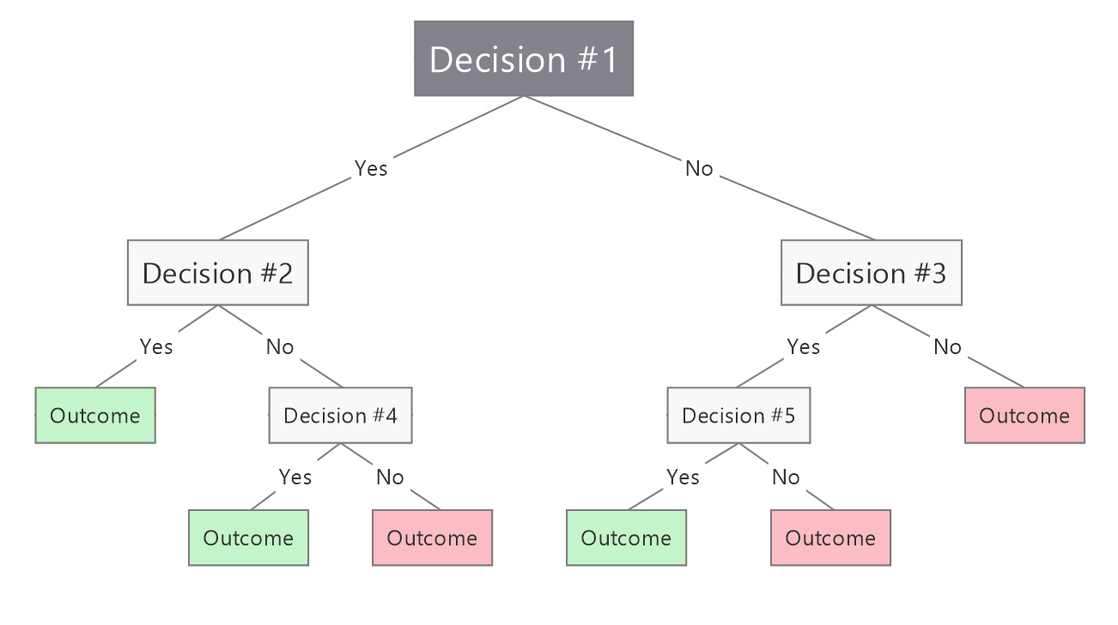
Let's Get Into The Backend Code!
Notes:
Aviral - Backend
Speech : Decision tree classification looks visually something like this (show the screen). It utilizes a mathematical concept called “entropy” that measures the “information gain” or in other words how much data you are able to gather out of each node. Using this calculation it figures out where to split and creates sections of similar data points called “leaf-nodes”. If this is getting too technical, an oversimplified definition of decision tree is “a flow chart with nested if conditions”.

Slide 5
Marketing
Target Audience
Hospitals, Clinics, Individual downloaders
Promotion
(Hospitals) Social Media campaigns, Advertising through calls and kind of door to door advertising
(Users) Social Media campaigns and posts.

Slide 6
Finances
Startup Costs- 2,000 Rs($25), 1 time cost for publishing.
Expenses- approximately 5000 rupees per year for app servers(Will increase when downloads increase). Advertising expenses 5000 starting.
Subscription for hospitals - 10-12% cut per patient fees for hospitals that have less than 100 patients per day. 8-10% depending on conversion rate for hospitals with more than 100 patients per day
Profit- approximately 120 Rs. per patient-doctor consultation (12% of 1000 {average patient fees of india})
Final Profit after taxes and all expenses- Approximately 30,000 per month
Tiers- Base tier, intermediate tier, Pro Tier
Notes:
Base tier- Just the base app with the doctor list, no fixed or one time cost, 8% cut for every doctor’s appointment

Slide 7
Our future plans for expansion
Notes:
Akshaj
Implementing a search feature in the app, that has a chatbot that asks you to search for any symptom, reaction or name of illness and gives you results based on that
Create a proper authentication service that sends out OTPs to login and has a database for Username, passwords and other details
Supporting the software for a long time, as well as updating the design elements, system base and security for newer and more modern standards
Creating COVID fighting technology, complete with hardware and software to give to our partnered hospitals and clinics if they buy a license of a high enough tier, as well as creating a mobile app to make managing the service a lot simpler

